Slide 1
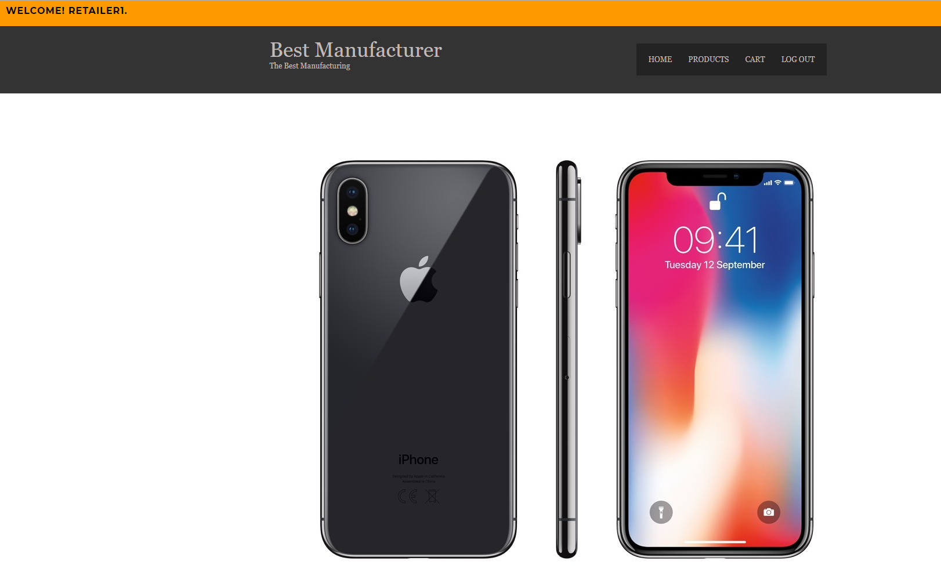
302CEM
Agile Development
(Group1-Supplier)

Slide 2

Group Member List
Cheung Yan Hin (53614440)
Chu Lok Yan (55188056)
Fung Shun Hei (54024863)
Kwong Sze Nok (54903808)
Tung Chi Hung (54438482)

Slide 3


Project Vision and Mission
Project Vision:
Manufacture leader in Hong Kong
Top 10 manufacture company in the world
Project Scope:
Login system for customers
Receive order from online retailer and check inventory
Deliver the products to customer through logistics provider

Slide 4
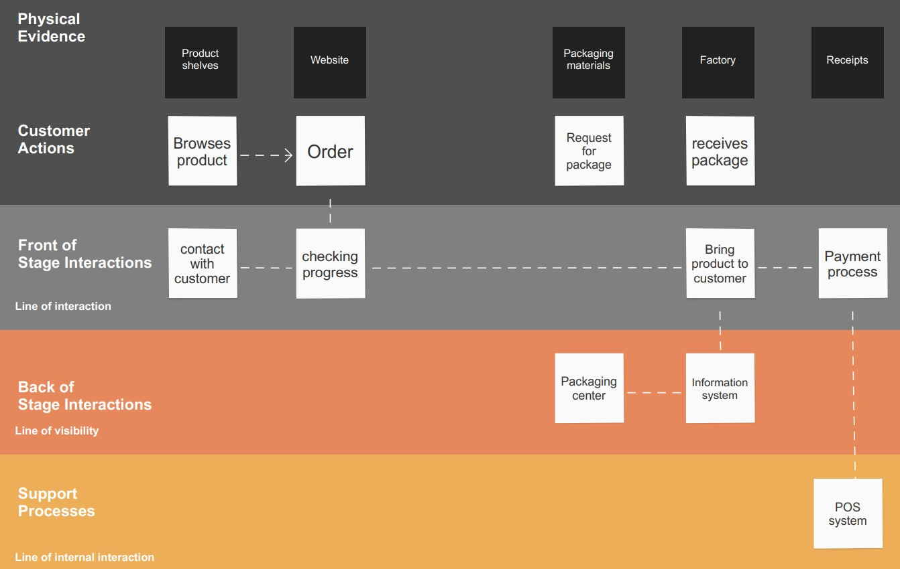
Service Blueprint
Used for service design and innovation, but has also found applications in diagnosing problems with operational efficiency.

Slide 5
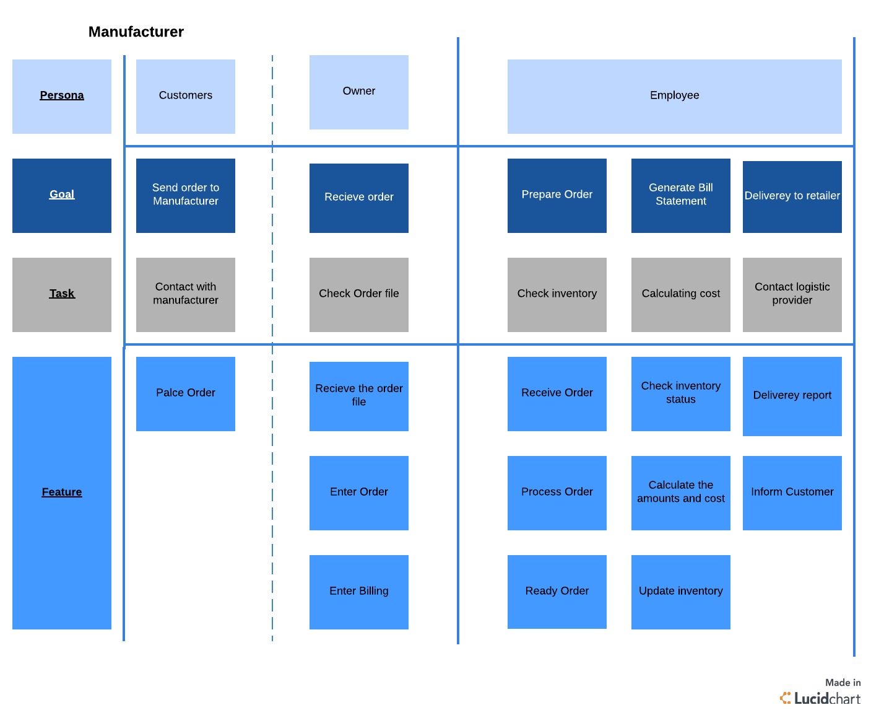
User Stories
Simple descriptions of a feature told from the perspective of the person who desires the new capability, usually a user or customer of the system.

Slide 6
User Stories
As a customer I want to contact with manufacturer so that l can send order.
As a owner l want to check file so that l can recieve order.
As a owner l want to enter order so that l can recieve payment.
As a employee l want to check the inventory so that l can prepare the order.
As a employee l want to calculate the cost so that l can generate the bill statement.
As a employee l want to contact logistic provider so that l can delivery the product

Slide 7
Gherkin Sample Template
Scenario: Receive order from customer
Given the customer request for <Product ID>
Check the inventory <Stock number>
Then I update <Status> to the customer
Examples:
| Product ID | Stock number | Status
| P0000001 | 200 | Available

Slide 8
Gherkin Sample template
Scenario: Generate bill to customers
Receiving the order from the customers
Generate <order ID>
Print out the <order details>
Example:
Order ID | Customer ID | Product ID | Product description
1 | C0000001 | P0000001 | iphone X 64GB

Slide 9
Gherkin Sample template
Scenario: Update the inventory
Produce the items <Product id>
Update the <stock>
Output the <stock>
Example:
| Product id | stock
| P0000001 | 100

Slide 10
Data Interface Layout
Customer
Customer_name | Customer_id | Phone_no | Email | Password
Retailer1 | C0000001 | +852 20000001 | retailer1@example.com | 11111111
Product
Product_id | Product_description | Stock | Unit price
P0000001 | Apple Iphone X 256GB | 100 | 6500

Slide 11
Data Interface Layout
Order_detail
Order_id | Customer_id | Product_id | Quantity | Total price | Order date
1 | C00000002 | P0000001 | 10 | 65000.00 | 2018-03-13

Slide 12
Agile Methodology
Product Backlog
Ordered list of all required work according to the user story of product owner
Product owner is prioritized to adjust the list
Works are ordered by priority, from high, medium to low.
Sprint Backlog
In this project, every two weeks is one sprint
List of tasks of user story that our team need to carry out before next sprint
Assign story points to describe the difficulty level abstractly （It is more difficult if the number is greater）
Estimated how many time we have to complete the sprint and calculate the remaining time

Slide 13
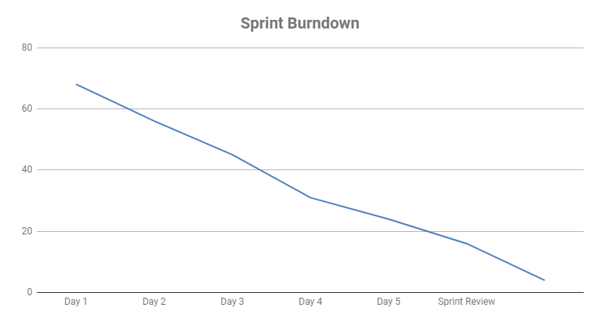
Agile Methodology
Burndown Chart
A line chart that display the remaining working hours in the sprint backlog
Review development progress

Slide 14
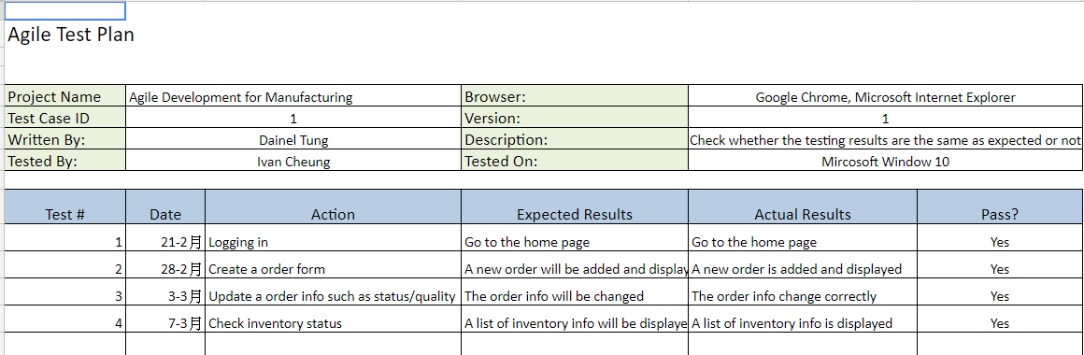
Agile Methodology
Test Plan
Record simple information of each tests, including date, action, expected results and actual results
If the actual results match the expected results, the test is pass

Slide 15
Video Cast
https://youtu.be/ifySrD2gIKI

Slide 16

END

